Slide 1

Umbraco Examine Search
By Svetlin Slavchev

Slide 2
Presentation content
What is Examine?
Implementation
Basic configuration
Custom configuration
Basic code examples
Examine interface in Umbraco back office
Additional modules
Conclusion and negatives

Slide 3
What is examine?

Slide 4
Examine, Umbraco Examine and Lucene
This is a provider based Indexer/Searcher API and wraps the Lucene.Net indexing/searching engine. Working with Examine is very easy and allows you to query or index almost any content in web site.
Umbraco Examine is the Umbraco implementation of Examine. It is not exclusive to Umbraco and can be used as a completely stand alone component on any project that needs a fast Index.
License
Examine is under Microsoft Public License (Ms-PL), and thats mean, we are free of charge to use it, but can not use it examine name, logo or trademark. More info - https://examine.codeplex.com/license?LicenseHistoryId=37500.

Slide 5
Implementation

Slide 6
Basic confuguration
All configuration comes whit main Umbraco installation.
You can start using examine search immediately.

Slide 7
Little Examine Terminology
Indexer - This is the object that performs the storing data into the index.
Searcher – The searcher is the object that performs the searching of data that is stored in the index.
Index Set - An index set is what defines an index, where the index is saved and how the information is stored in the index.
Naming conventions
Our Indexer, Searcher and associated Index Set must all be named according to convention so that they match.
Conventions:
{name}Indexer
{name}Searcher
{name}IndexSet
Examples:
ExternalIndexer
ExternalSearcher
ExternalIndexSet

Slide 8
Look in the config folder.
- /Config/ExamineIndex.config
By default is configured 3 IndexSets – InternalIndexSet, InternalMemberIndexSet and ExternalIndexSet.
All index sets that starts with ‘Internal’ prefix are internal umbraco and we don not have work there. The same is valid also for searchers and indexers. Umbraco provides for us ExternalIndexSet:
<IndexSet SetName="ExternalIndexSet“ IndexPath="~/App_Data/TEMP/ExamineIndexes/External/“/>
We can extend this configuration, but this will be seen in next sliders. For now we can search in all site content(fields and document types).

Slide 9
…
- /Config/ExamineSettings.config
There is ExamineIndexProviders and ExamineSearchProviders. Also by three of kind – two internals and external.
ExternalIndexer
<add name="ExternalIndexer" type="UmbracoExamine.UmbracoContentIndexer, UmbracoExamine"/>
ExternalSearcher
<add name="ExternalSearcher" type="UmbracoExamine.UmbracoExamineSearcher, UmbracoExamine"/>

Slide 10
ExternalIndexer
We can extend it with this additional properties:
dataService - the type that this provider will instantiate in order to query Umbraco for the data that it requires. Generally this shouldn't need to change unless you want to use test data from a non-umbraco source or you have very custom requirements.
indexSet - explicitly specifies the index set to use. Generally this wired up based on naming convensions.
supportUnpublished - if you want the indexer to index content that is not published.
supportProtected - if you want the indexer to index content that is protected.
runAsync = will process the queue files into the index asynchronously, unless you are testing, this should always be true.
interval = how often the async service will process the file queue in seconds.
analyzer = the Lucene.Net analyzer to use when storing data. See: http://www.aaron-powell.com/lucene-analyzer.
enableDefaultEventHandler = will automatically listen for Umbraco events and index when required.
logLevel="Info" or "Verbose". Info is the default, Verbose will show more detailed logs

Slide 11
ExternalSearcher
We can extend it with this additional property:
indexSet - explicitly specifies the index set to use. Generally this wired up based on naming convensions.
Note:
In ExamineSearchProviders section, defaultProvider must be the name of our search provider - e.g. – ExternalSearcher. This is by default.
<ExamineSearchProviders defaultProvider="ExternalSearcher">

Slide 12
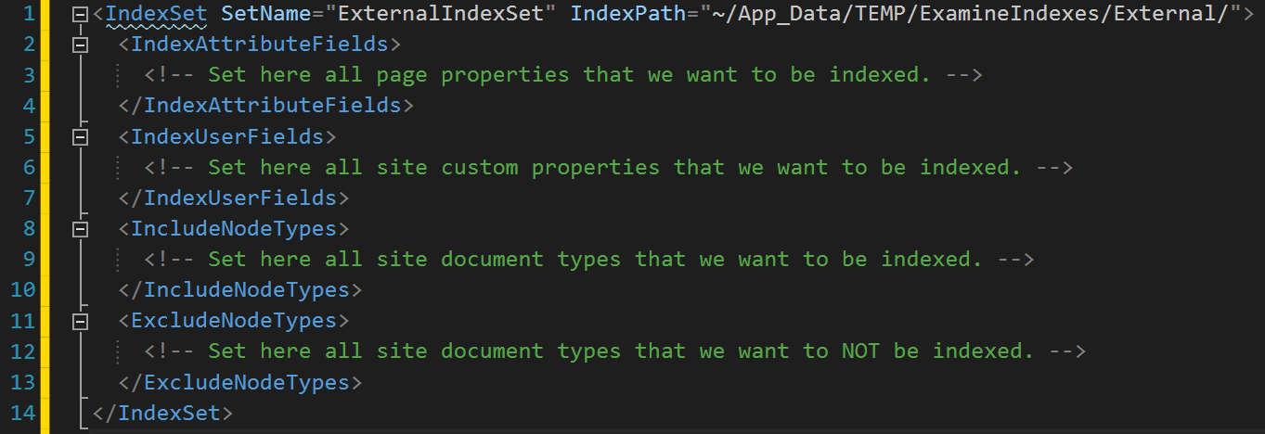
Custom configuration

Slide 13
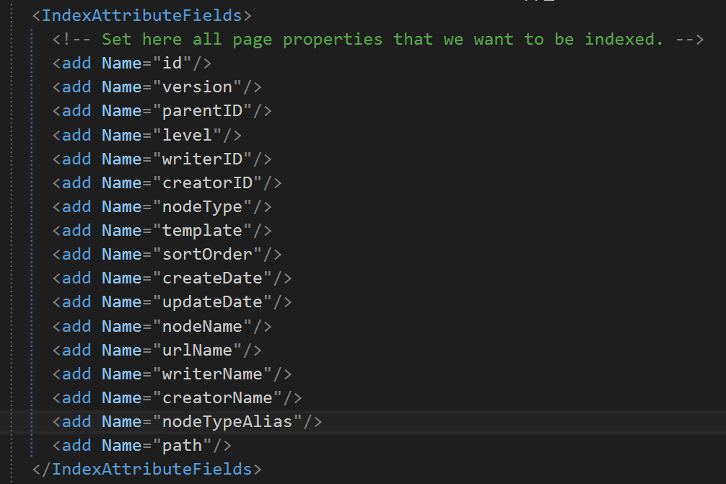
Custom IndexSet - IndexAttributeFields

Slide 14
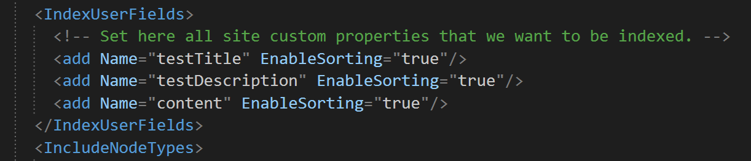
Custom IndexSet - IndexUserFields

Slide 15
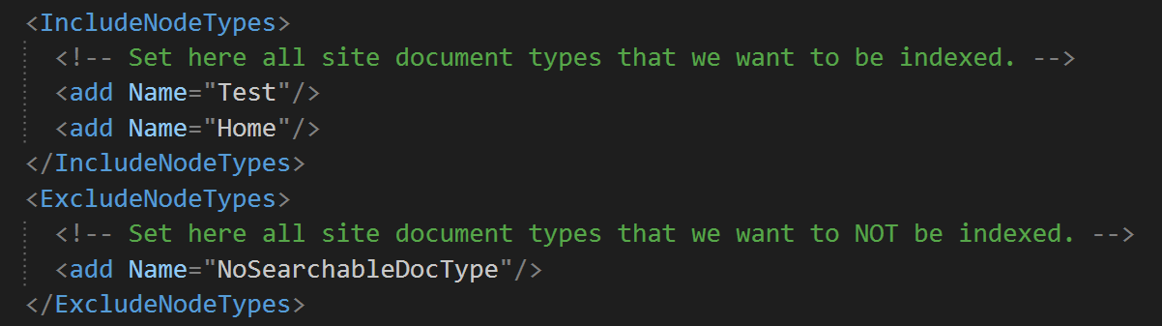
Custom IndexSet – IncludeNodeTypes and ExcludeNodeTypes

Slide 16
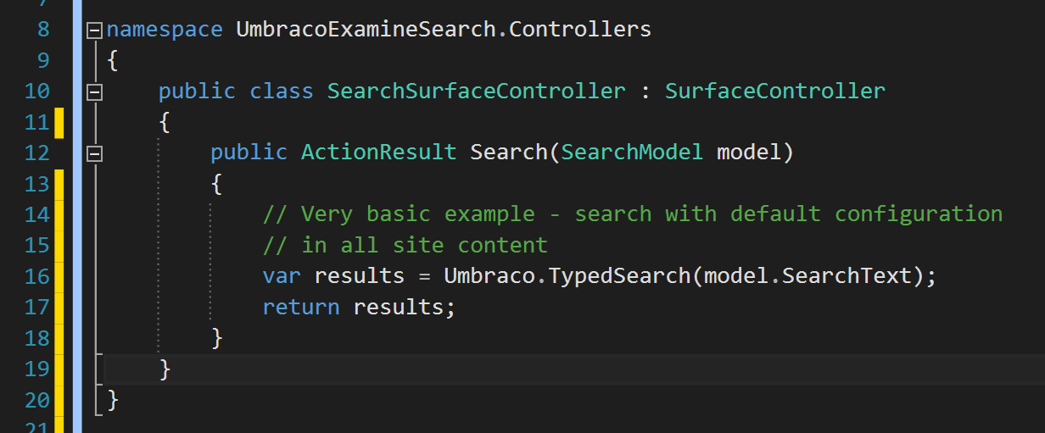
Code behind customization

Slide 17
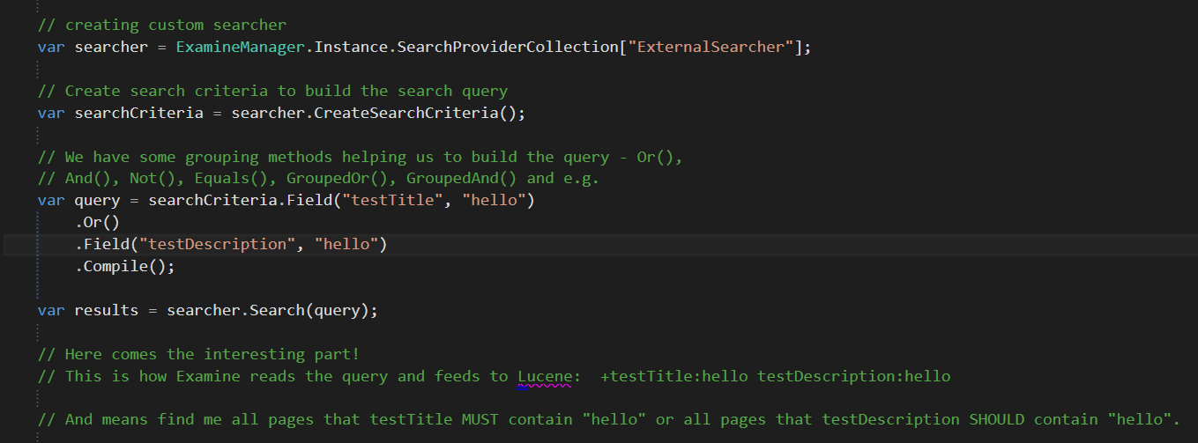

Slide 18
Difference between Lucene boolean clauses – MUST and SHOULD
Assume that there are two clauses: Clause A and Clause B.
Clause A have SHOULD, Clause B – SHOULD
This will imply that even if one of the clause is satisfied (A or B), then the document will be a hit.
Clause A have MUST, Clause B - SHOULD
In this case, a document will be a hit when it "will" satisfy clause A whether this document satisfies clause B or not.
But if the document does not satisfies clause A, then no matter whether it satisfies clause B or not, it will not be a hit.
Clause A have MUST, Clause B - MUST
In this case, a document will be a hit, only when it will satisfy "both" the clauses. If it will fail to satisfy even one of the clause, then it will not be a hit.

Slide 19
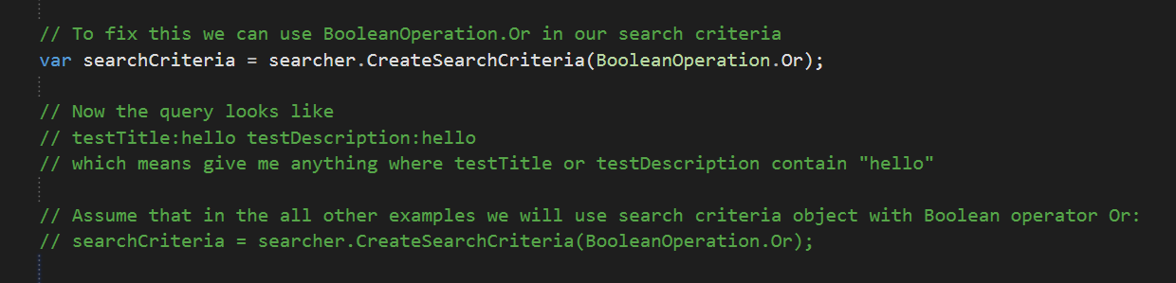
Examples

Slide 20
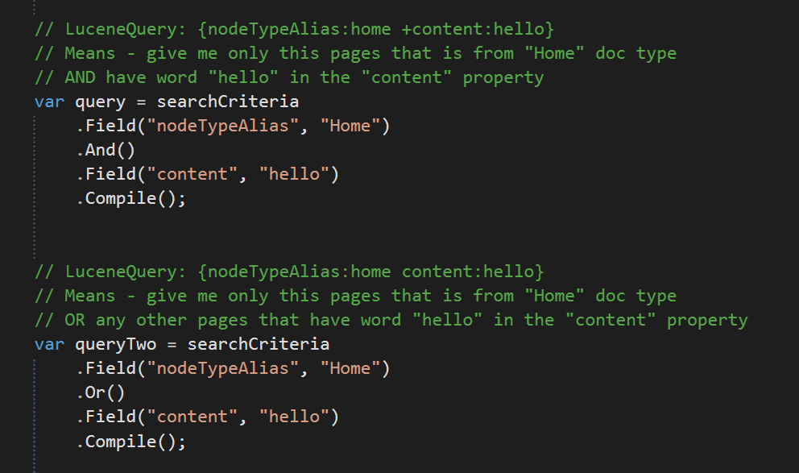
Еxamples

Slide 21
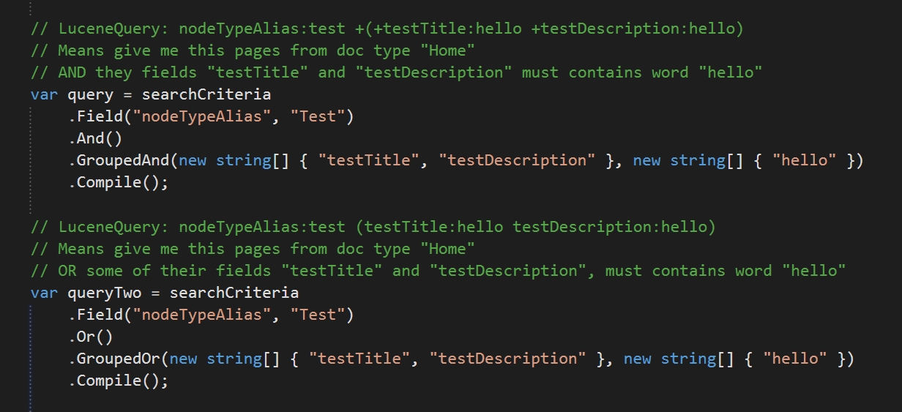
Еxamples

Slide 22
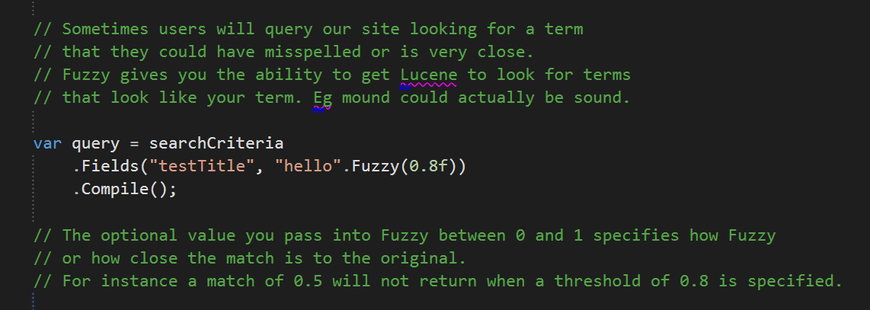
Fuzzy

Slide 23
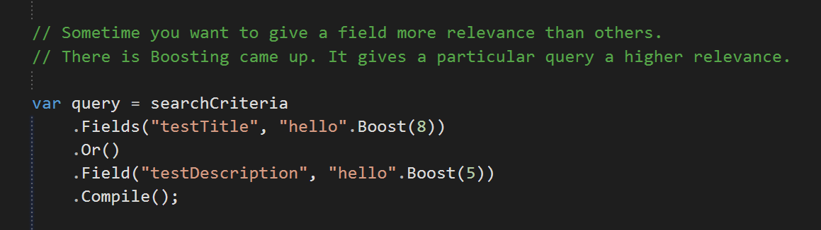
Boosting

Slide 24
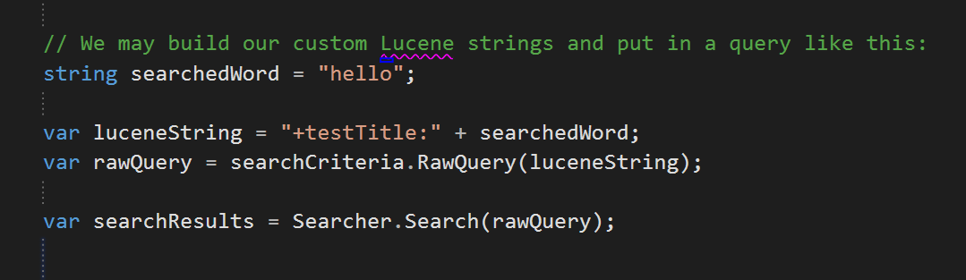
Raw Lucene Queries

Slide 25
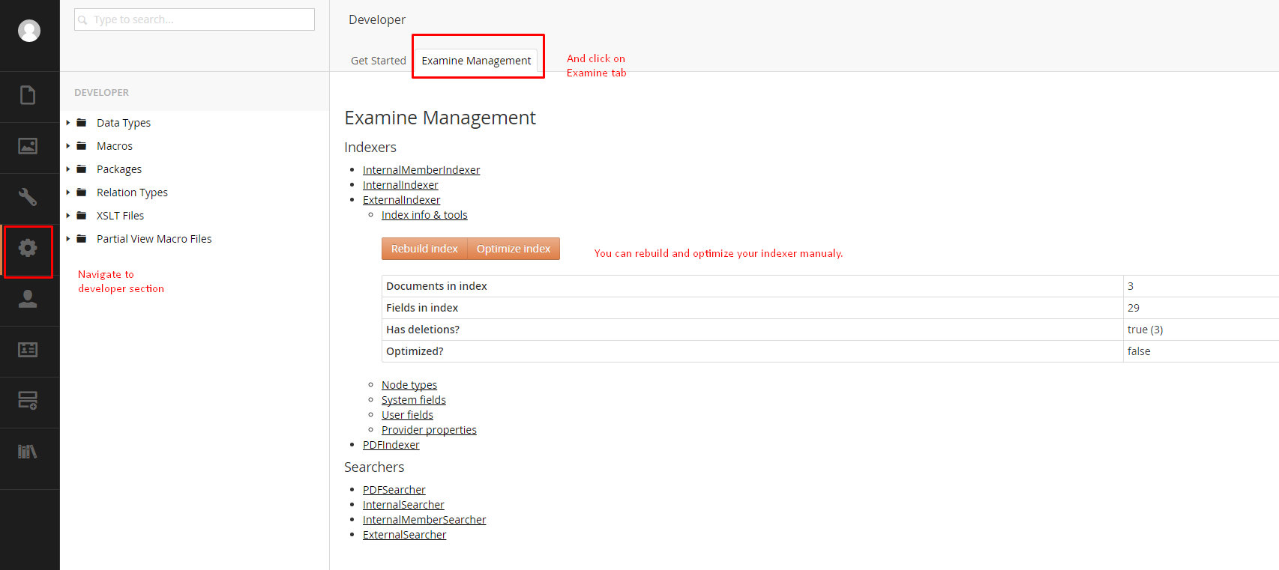
Examine interface in Umbraco back office

Slide 26
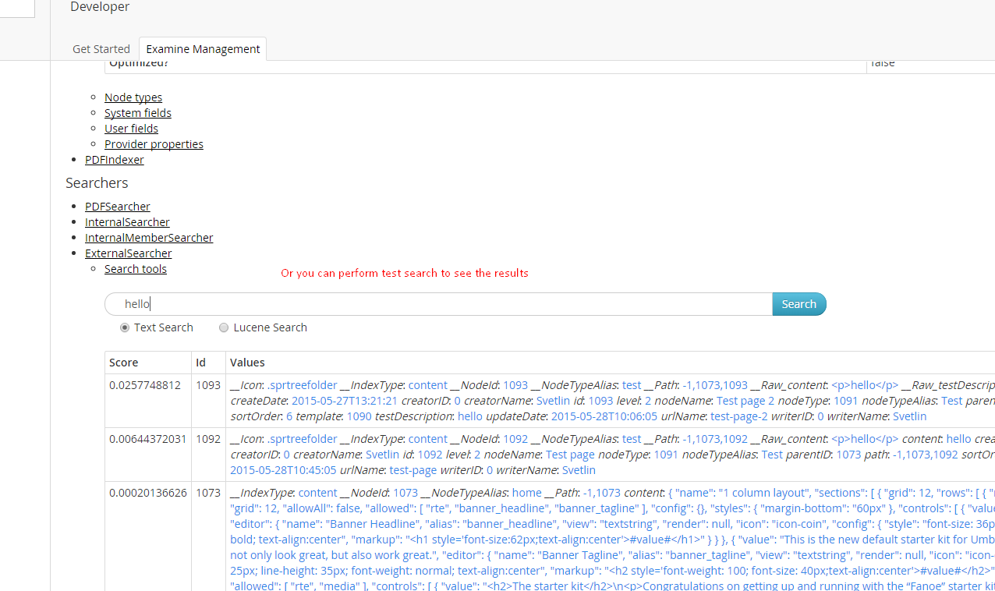

Slide 27
Additional modules

Slide 28
Umbraco indexing for PDF files
This module will add new Indexer and Searcher to ~/Config/ExamineSettings.config
called: "PDFIndexer" and "PDFSearcher"
and new Index Set to ~/Config/ExamineIndex.config called "PDFIndexSet"
After that you can search in selected pdf files, using the Examine Search API like examples below. But you need to specify your searcher:
var searcher = ExamineManager.Instance.SearchProviderCollection["PDFSearcher"];
You can install this module via NuGet – use user interface or type this command in Package manager console in Visual studio:
Install-Package UmbracoCms.UmbracoExamine.PDF

Slide 29
Conclusion and negatives

Slide 30
Conclusion
Lucene is super fast search engine and after the Umbraco Examine steps of this platform, we have in our hands very powerful tool.
As you see - working and managing all this resources is very easy, so I can not say any negative comments about Umbraco Examine.

